Slide 1


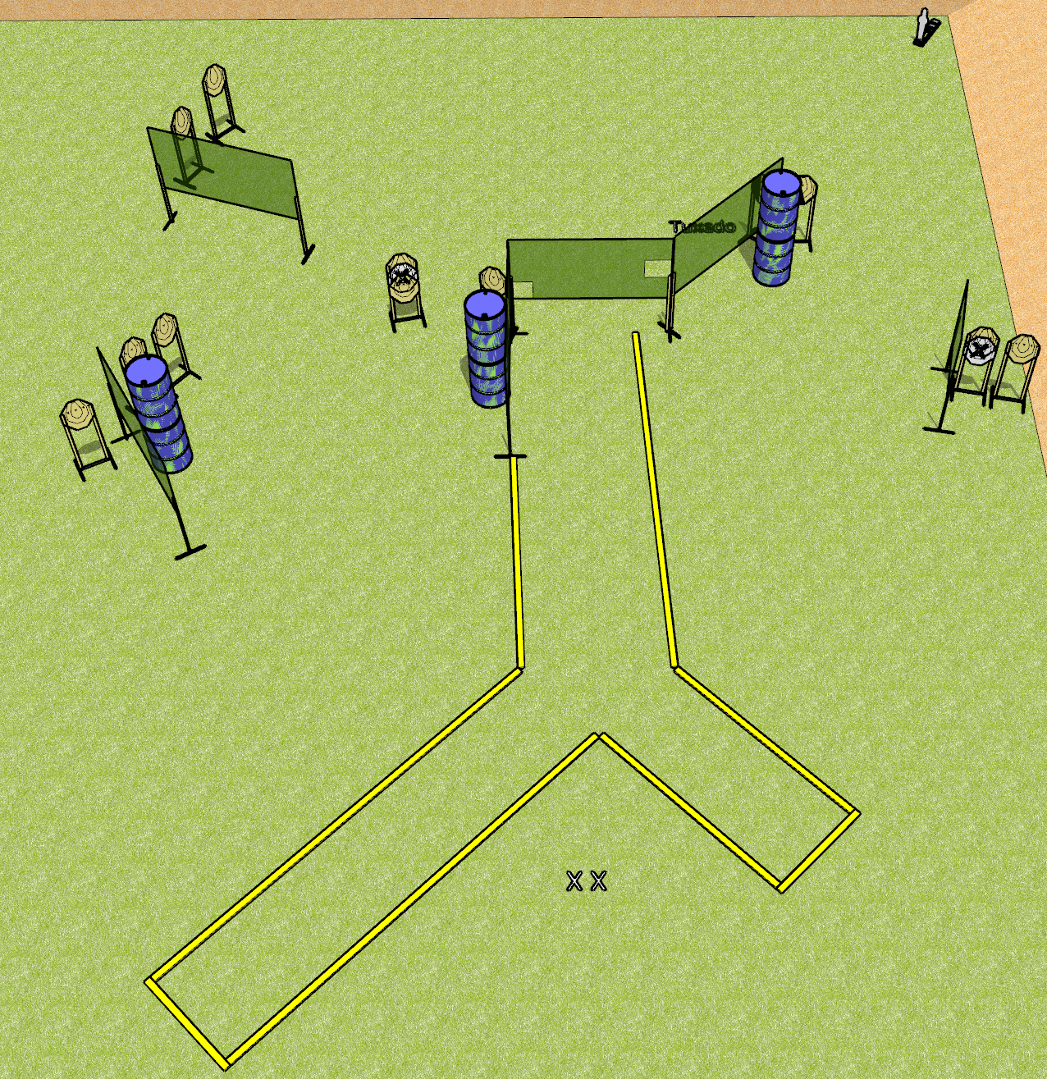
 | Dothan Gun Club – USPSA Match Angles Course Designer : Drew Coleman
Round Count 25 rounds 12 IPSC 1 mini popper
Equipment List 2 medium fault lines 11 wall feet 1 tux, 1 left diagonal

Slide 2
Angles
Written Stage Briefing
Angles is a 25 round, 125 point, Comstock course of fire. There are 12 IPSC targets and 1 mini popper. The best 2 hits on paper will score, and steel must fall to score. The start signal is audible.
Handgun start position is both feet on X’s, wrists below belt. Handgun is loaded and holstered.
PCC start position is both feet on X’s, stock on belt. Loaded carbine is held with both hands, safety on.
On start signal, engage targets as they become available from within the shooting area.

